Slide 1
Data Migration Quality Analysis
Presented by Jeffrey Benson

Slide 2
Agenda
01 | Process
02 | Findings
03 | Interactive Samples
04 | Next Steps

Slide 3
Data Pipeline Process (ELT)
Ingest
1
Summarize
5
Validate & Transform
2
Analyze
3
Quantify
4
Sources | Pre-Migration Source | Delta | Post-Migration New
Beneficiary Summary Records | 343,644 | 0 | 343,644
Carrier Claim Records | 4,741,335 | +4,777 | 4,746,112
Notes:
Ingested CSV files into duckdb database utilizing python.
Validated row counts and row sums matched between CSV and ingested data, validating ingestion quality.
Performed deep dive analysis utilizing python and SQL:
Identified every row and column that does not match between the legacy “source” and the “new” data.
Produced lists of variances.
Analyzed the PDF files for key themes.
Analyzed financial impact variances by column.

Slide 4
Capability of Migration Process
Data Set | Total Rows | Defective Data Elements | Total Data Elements | DPMO* | Process Yield | Sigma
Carrier Claims | 4,746.1K | 530.4K | 484,150.9K | 1095.5 | 99.89045% | ~4.56
Beneficiary Summary | 343.6K | 8.2K | 10,657.9K | 768.7 | 99.92313% | ~4.67
“Six Sigma” represents a process capability with a 99.99966% yield, or 3.4 defects per million opportunities.
Data Migration Process Capability:
Carrier Claims: 99.89045% yield, or 1,095.5 defects per million opportunities*.
Beneficiary Summary: 99.92313% yield, or 768.7 defects per million opportunities*.

Slide 5
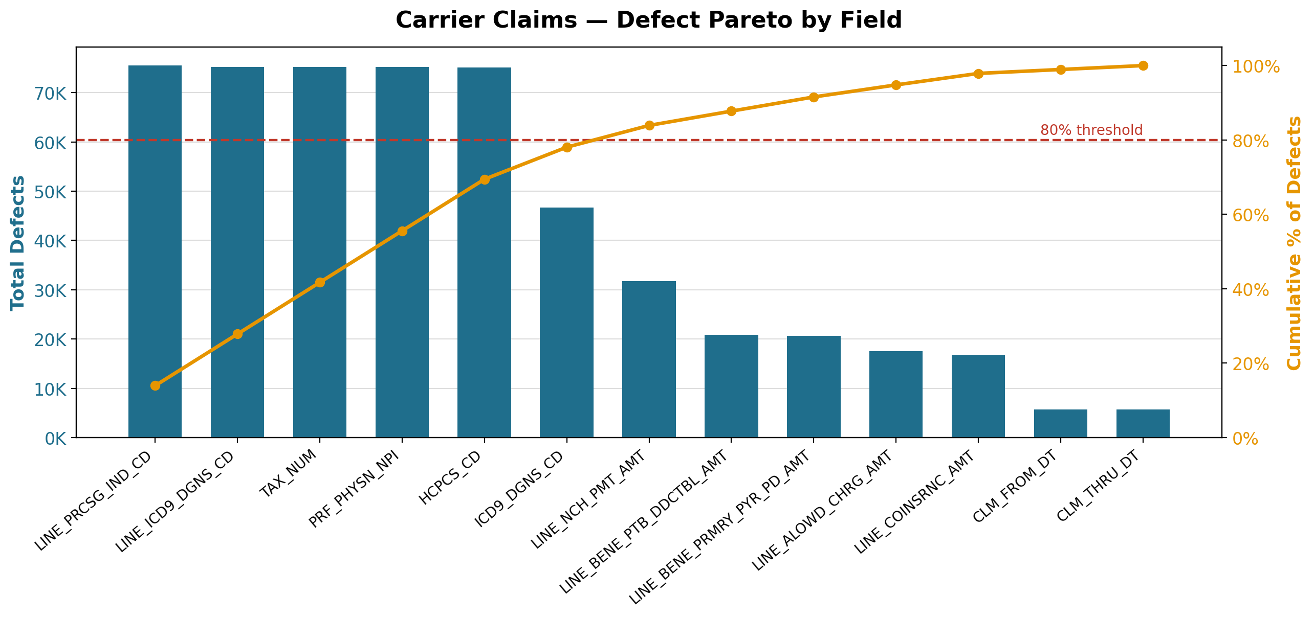

Slide 6
Pareto Analysis of Claims Data Defects
SOURCE | DATA SET | TOTAL DEFECTS | RUNNING PCT | DPMO | SIGMA LEVEL
Carrier Claims | LINE_PRCSG_IND_CD | 75,497 | 13.93% | 15,906 | 3.656
Carrier Claims | LINE_ICD9_DGNS_CD | 75,238 | 27.82% | 15,851 | 3.657
Carrier Claims | TAX_NUM | 75,176 | 41.70% | 15,838 | 3.658
Carrier Claims | PRF_PHYSN_NPI | 75,169 | 55.57% | 15,836 | 3.658
Carrier Claims | HCPCS_CD | 75,106 | 69.43% | 15,823 | 3.658
Carrier Claims | ICD9_DGNS_CD | 46,708 | 78.05% | 9,840 | 3.844
Carrier Claims | LINE_NCH_PMT_AMT | 31,709 | 83.91% | 6,680 | 3.988
Carrier Claims | LINE_BENE_PTB_DDCTBL_AMT | 20,828 | 87.75% | 4,388 | 4.137
Carrier Claims | LINE_BENE_PRMRY_PYR_PD_AMT | 20,639 | 91.56% | 4,348 | 4.141
Carrier Claims | LINE_ALOWD_CHRG_AMT | 17,531 | 94.80% | 3,693 | 4.197
Carrier Claims | LINE_COINSRNC_AMT | 16,775 | 97.89% | 3,534 | 4.211
Carrier Claims | CLM_FROM_DT | 5,707 | 98.95% | 1,202 | 4.553
Carrier Claims | CLM_THRU_DT | 5,707 | 100.00% | 1,202 | 4.553

Slide 7
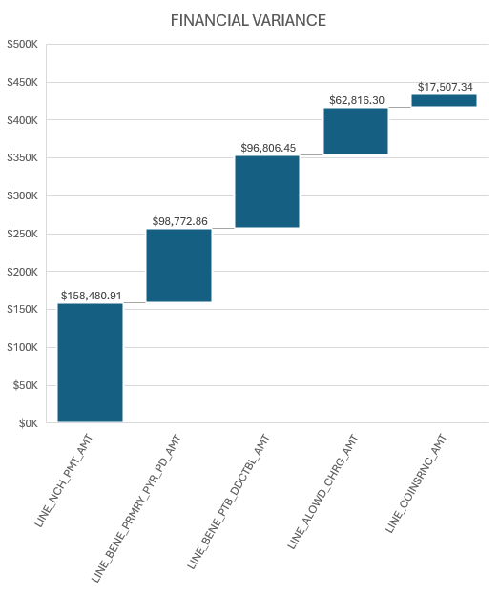
Financial Impact of Claims Data Defects
DATA SET | FINANCIAL VARIANCE | RUNNING PCT OF TOTAL
LINE_NCH_PMT_AMT | $ 158,480.91 | 36.48%
LINE_BENE_PRMRY_PYR_PD_AMT | $ 98,772.86 | 59.22%
LINE_BENE_PTB_DDCTBL_AMT | $ 96,806.45 | 81.51%
LINE_ALOWD_CHRG_AMT | $ 62,816.30 | 95.97%
LINE_COINSRNC_AMT | $ 17,507.34 | 100.00%
TOTAL | $ 434,383.86 | 100.00%

Slide 8
Pareto Analysis of Beneficiary Data Defects
SOURCE | DATA SET | TOTAL DEFECTS | RUNNING PCT | DPMO | SIGMA LEVEL
Beneficiary Summary | BENE_BIRTH_DT | 496 | 6.05% | 1,443 | 4.498
Beneficiary Summary | BENE_HI_CVRAGE_TOT_MONS | 337 | 10.17% | 980 | 4.613
Beneficiary Summary | BENE_SMI_CVRAGE_TOT_MONS | 322 | 14.10% | 937 | 4.626
Beneficiary Summary | BENE_COUNTY_CD | 318 | 17.98% | 925 | 4.629
Beneficiary Summary | BENE_DEATH_DT | 318 | 21.86% | 925 | 4.629
Beneficiary Summary | BENE_ESRD_IND | 318 | 25.74% | 925 | 4.629
Beneficiary Summary | BENE_RACE_CD | 318 | 29.62% | 925 | 4.629
Beneficiary Summary | BENE_SEX_IDENT_CD | 318 | 33.50% | 925 | 4.629
Beneficiary Summary | SP_ALZHDMTA | 318 | 37.39% | 925 | 4.629
Beneficiary Summary | SP_CHF | 318 | 41.27% | 925 | 4.629
Beneficiary Summary | SP_CHRNKIDN | 318 | 45.15% | 925 | 4.629
Beneficiary Summary | SP_CNCR | 318 | 49.03% | 925 | 4.629
Beneficiary Summary | SP_COPD | 318 | 52.91% | 925 | 4.629
Beneficiary Summary | SP_DEPRESSN | 318 | 56.79% | 925 | 4.629
Beneficiary Summary | SP_DIABETES | 318 | 60.67% | 925 | 4.629
Beneficiary Summary | SP_ISCHMCHT | 318 | 64.56% | 925 | 4.629
Beneficiary Summary | SP_OSTEOPRS | 318 | 68.44% | 925 | 4.629
Beneficiary Summary | SP_RA_OA | 318 | 72.32% | 925 | 4.629
Beneficiary Summary | SP_STATE_CODE | 318 | 76.20% | 925 | 4.629
Beneficiary Summary | SP_STRKETIA | 318 | 80.08% | 925 | 4.629
Beneficiary Summary | PLAN_CVRG_MOS_NUM | 289 | 83.61% | 841 | 4.657
Beneficiary Summary | BENRES_CAR | 272 | 86.93% | 791 | 4.674
Beneficiary Summary | MEDREIMB_CAR | 260 | 90.10% | 756 | 4.687
Beneficiary Summary | MEDREIMB_OP | 215 | 92.73% | 625 | 4.740
Beneficiary Summary | BENRES_OP | 195 | 95.11% | 567 | 4.766
Beneficiary Summary | BENE_HMO_CVRAGE_TOT_MONS | 124 | 96.62% | 361 | 4.886
Beneficiary Summary | PPPYMT_CAR | 78 | 97.57% | 227 | 5.002
Beneficiary Summary | MEDREIMB_IP | 68 | 98.40% | 198 | 5.035
Beneficiary Summary | BENRES_IP | 62 | 99.16% | 180 | 5.057
Beneficiary Summary | PPPYMT_IP | 36 | 99.60% | 105 | 5.182
Beneficiary Summary | PPPYMT_OP | 33 | 100.00% | 96 | 5.201
1,322 Beneficiary Records do not match between the Pre- & Post-Migration tables.
One or more data fields are out of sync.
Defects are distributed almost uniformly across ~25 fields (~318 each), indicating a systemic migration fault affecting most fields equally —not a few broken columns.
This points root-cause analysis at the migration process itself rather than specific fields.

Slide 9
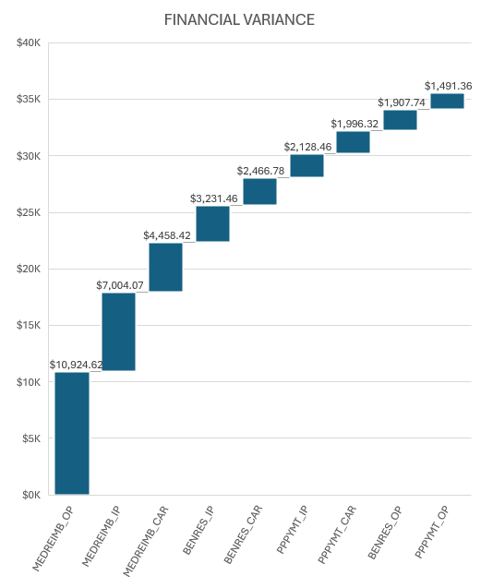
Financial Impact of Beneficiary Data Defects
DATA SET | FINANCIAL VARIANCE | RUNNING PCT OF TOTAL
MEDREIMB_OP | $ 10,924.62 | 30.68%
MEDREIMB_IP | $ 7,004.07 | 50.35%
MEDREIMB_CAR | $ 4,458.42 | 62.87%
BENRES_IP | $ 3,231.46 | 71.94%
BENRES_CAR | $ 2,466.78 | 78.87%
PPPYMT_IP | $ 2,128.46 | 84.85%
PPPYMT_CAR | $ 1,996.32 | 90.45%
BENRES_OP | $ 1,907.74 | 95.81%
PPPYMT_OP | $ 1,491.36 | 100.00%
TOTAL | $ 35,609.23 | 100.00%

Slide 10
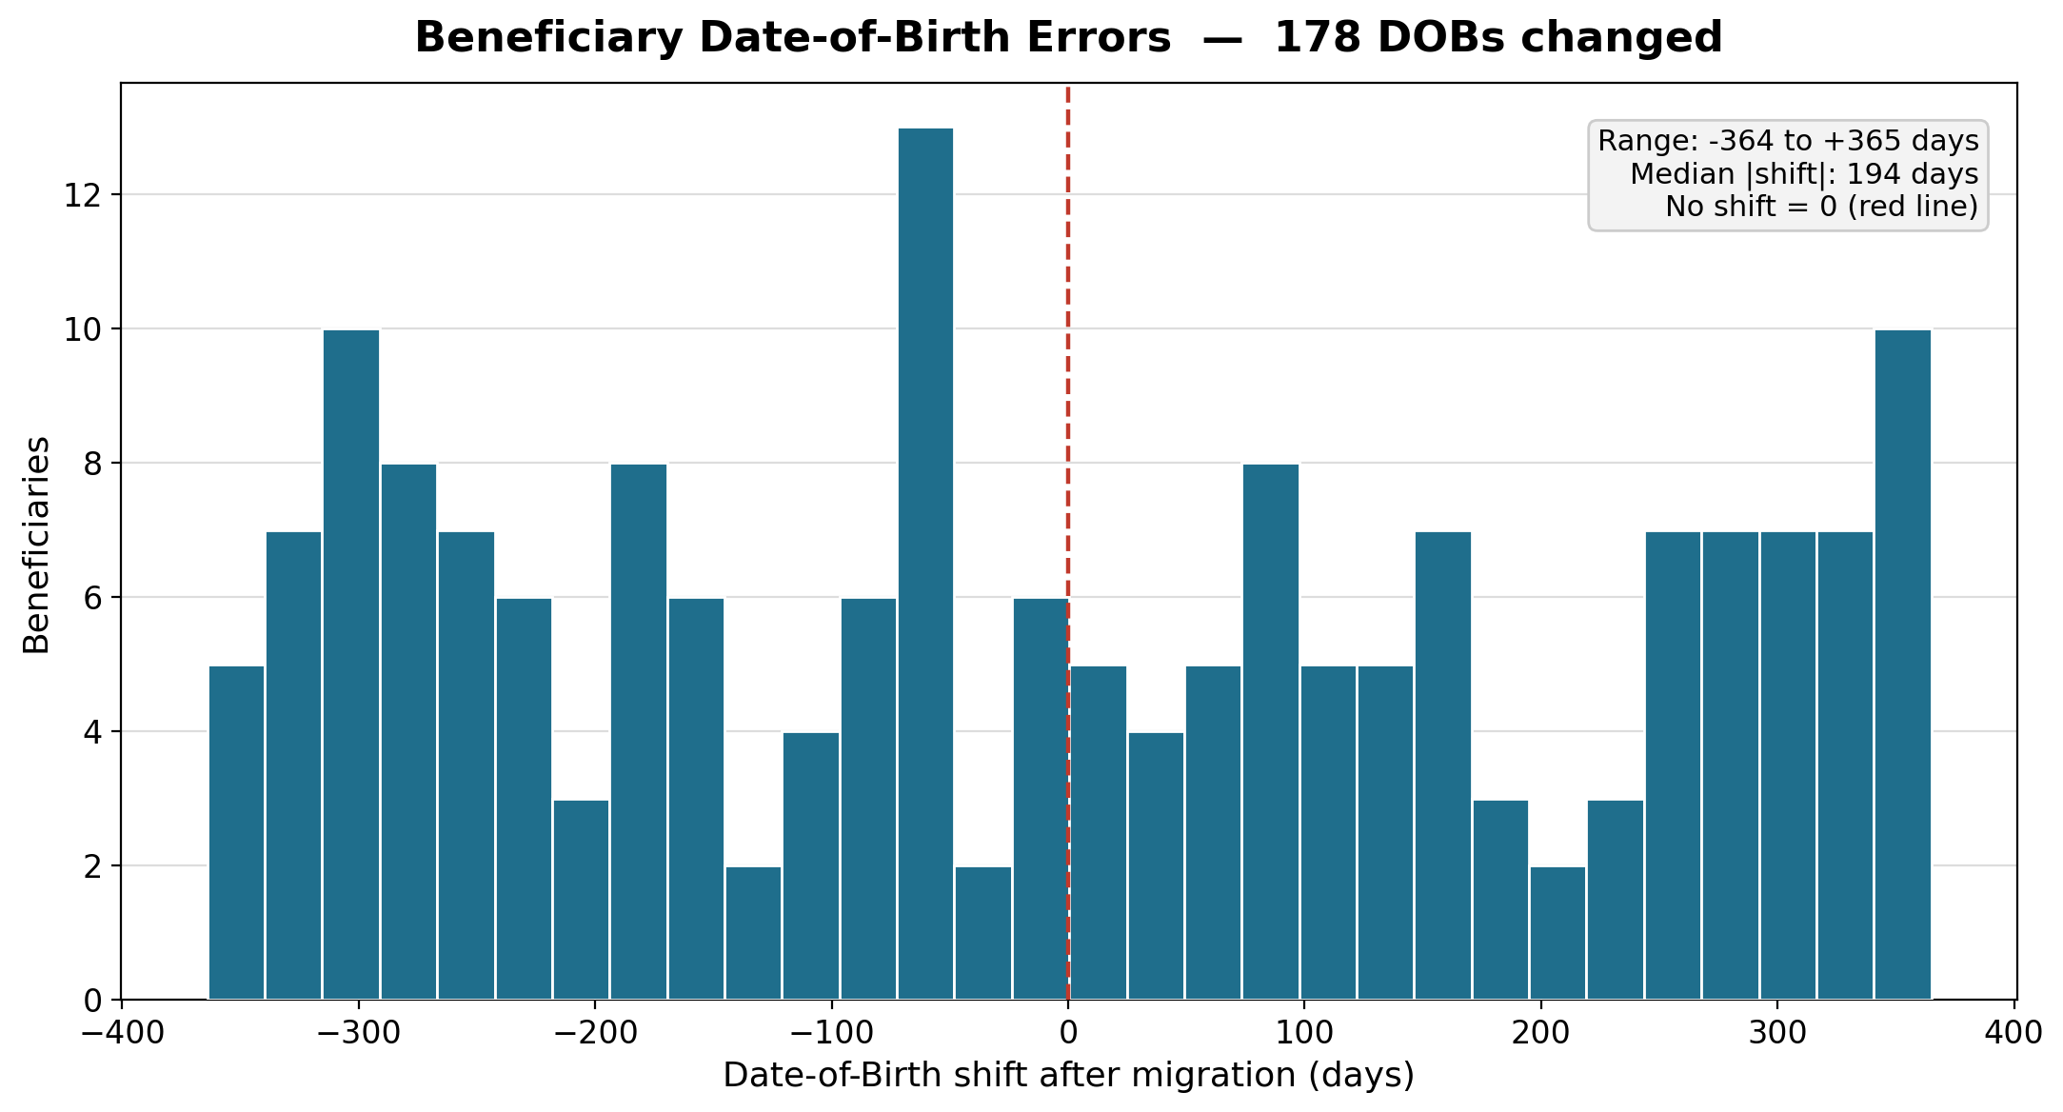
Beneficiary “Date of Birth” Errors
178 Beneficiary “Dates of Birth” changed after the Migration

Slide 11
Carrier Claims Orphan Analysis
“New” records in Carrier Claims Post Migration
4,777 orphans w/ 2-key match
(DESYNPUF_ID | CLM_ID)
5,242 orphans w/ 4-key match
(DESYNPUF_ID | CLM_ID | CLM_FROM_DT | CLM_THRU_DT)
Orphans Increased w/ 4-key match due to defects in
CLM_FROM_DT and CLM_THRU_DT Post-Migration

Slide 12
Beneficiary ID Errors
159 Missing in New File
159 Missing in Original file
Need to Investigate: If same persons, why did the IDs change post migration?

Slide 13
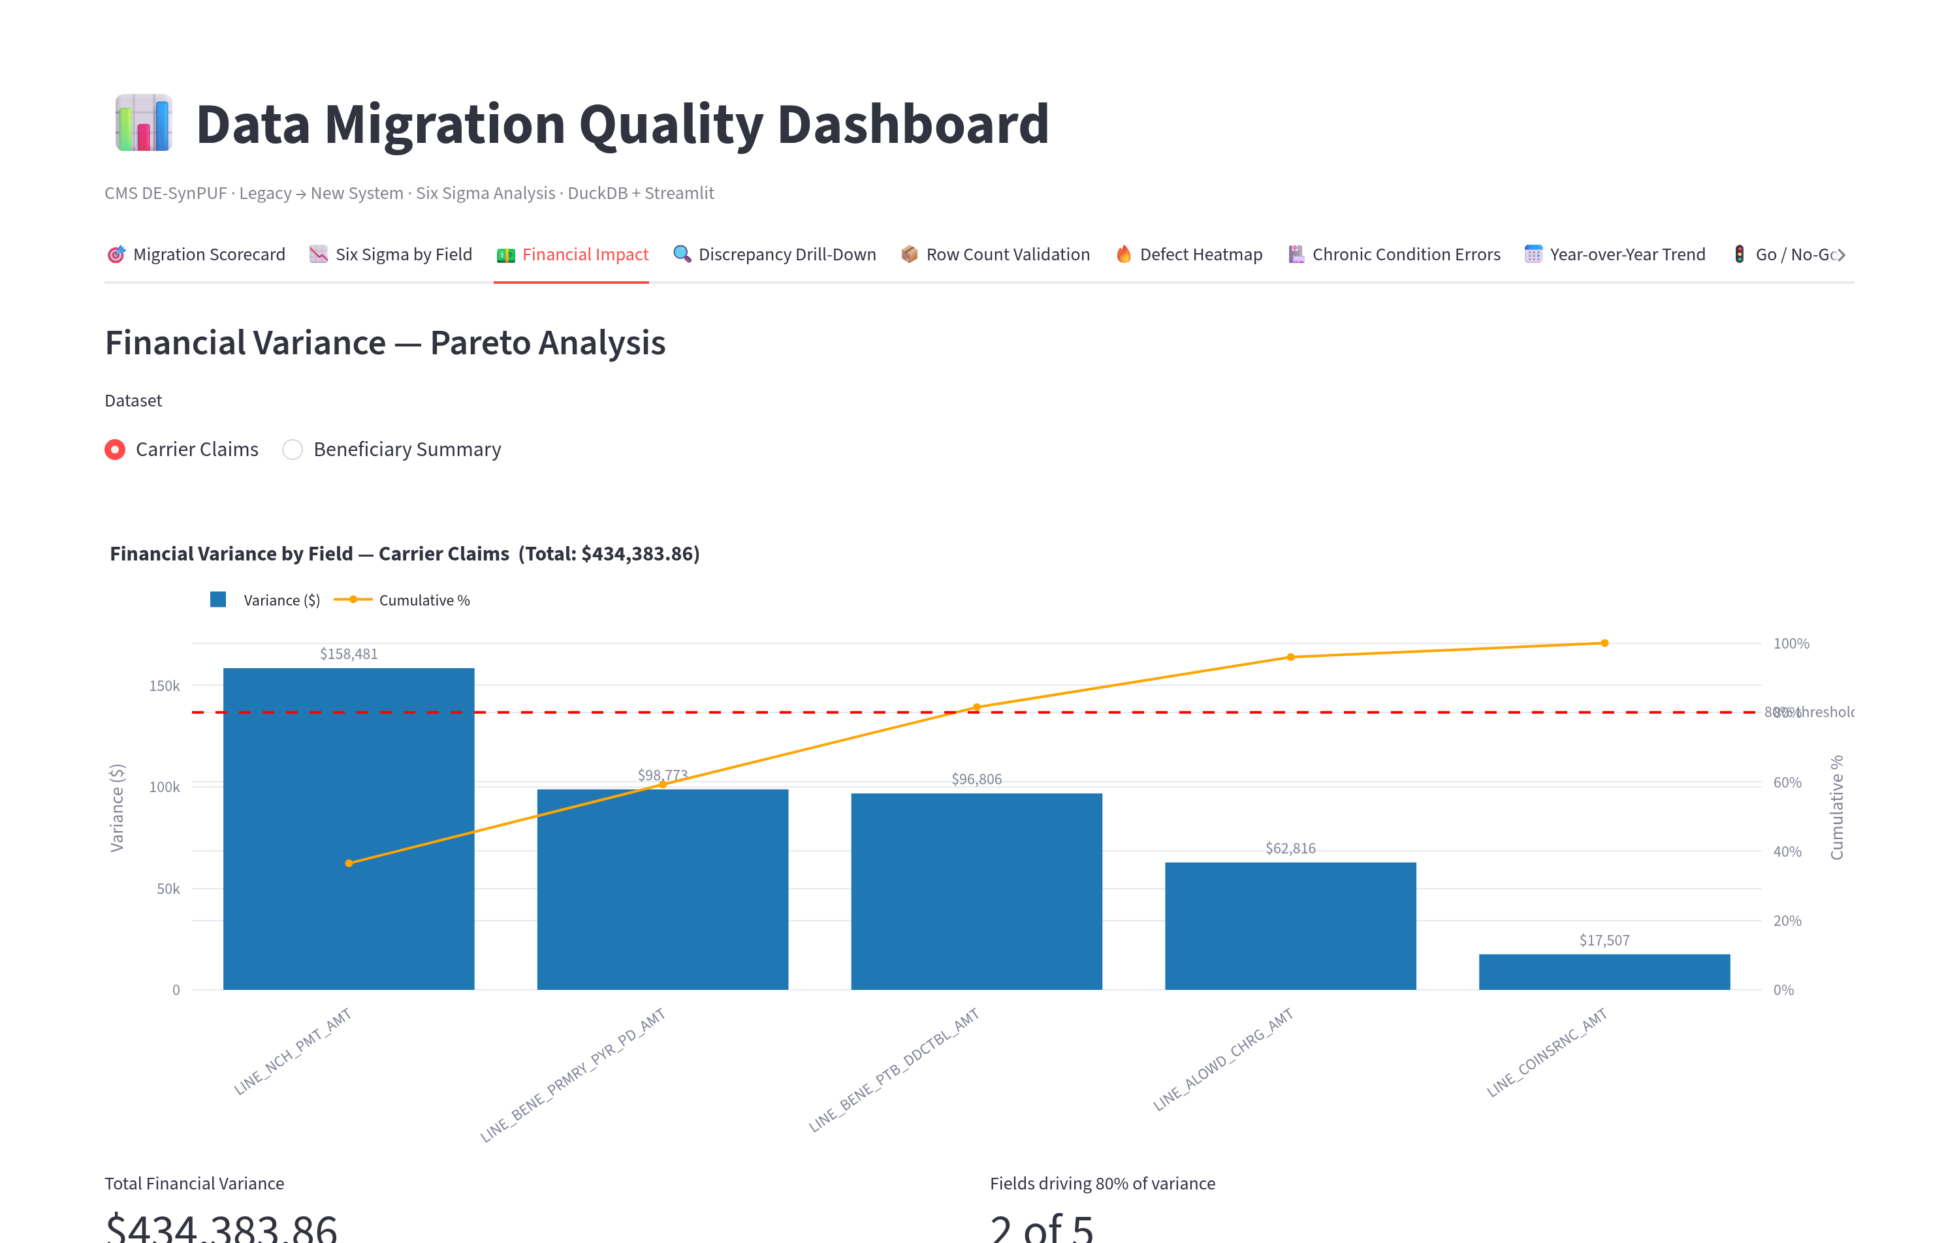
Interactive Dashboard – Financial Pareto

Slide 14
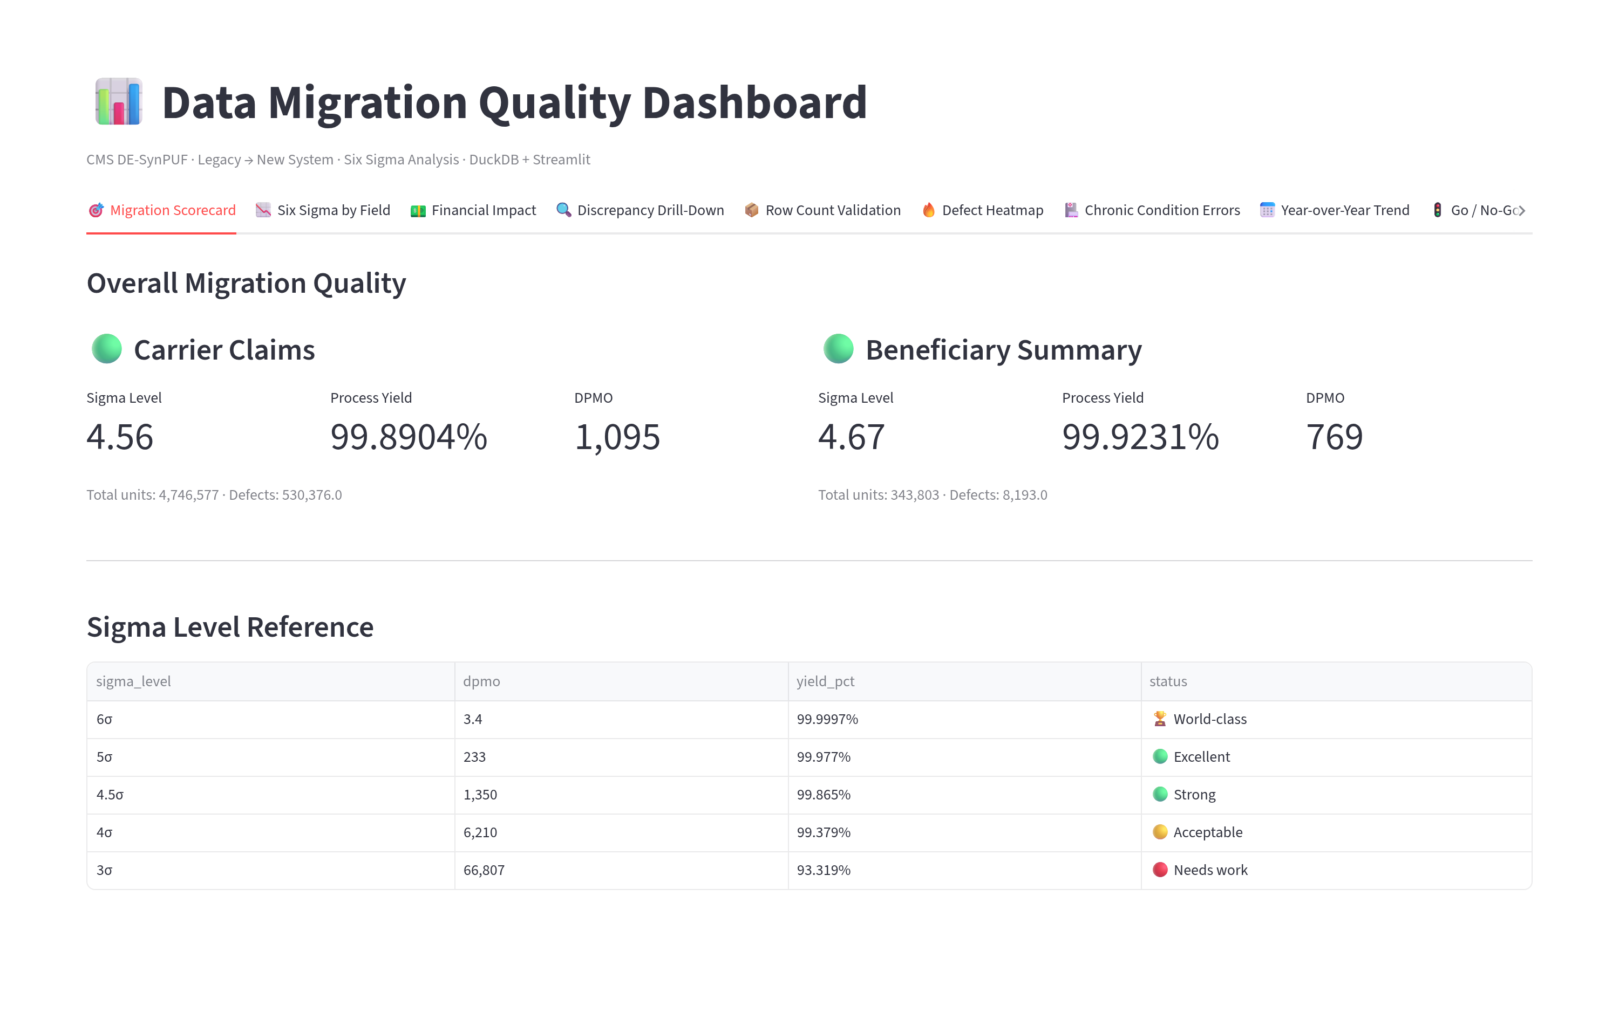
Interactive Dashboard – Scorecard

Slide 15
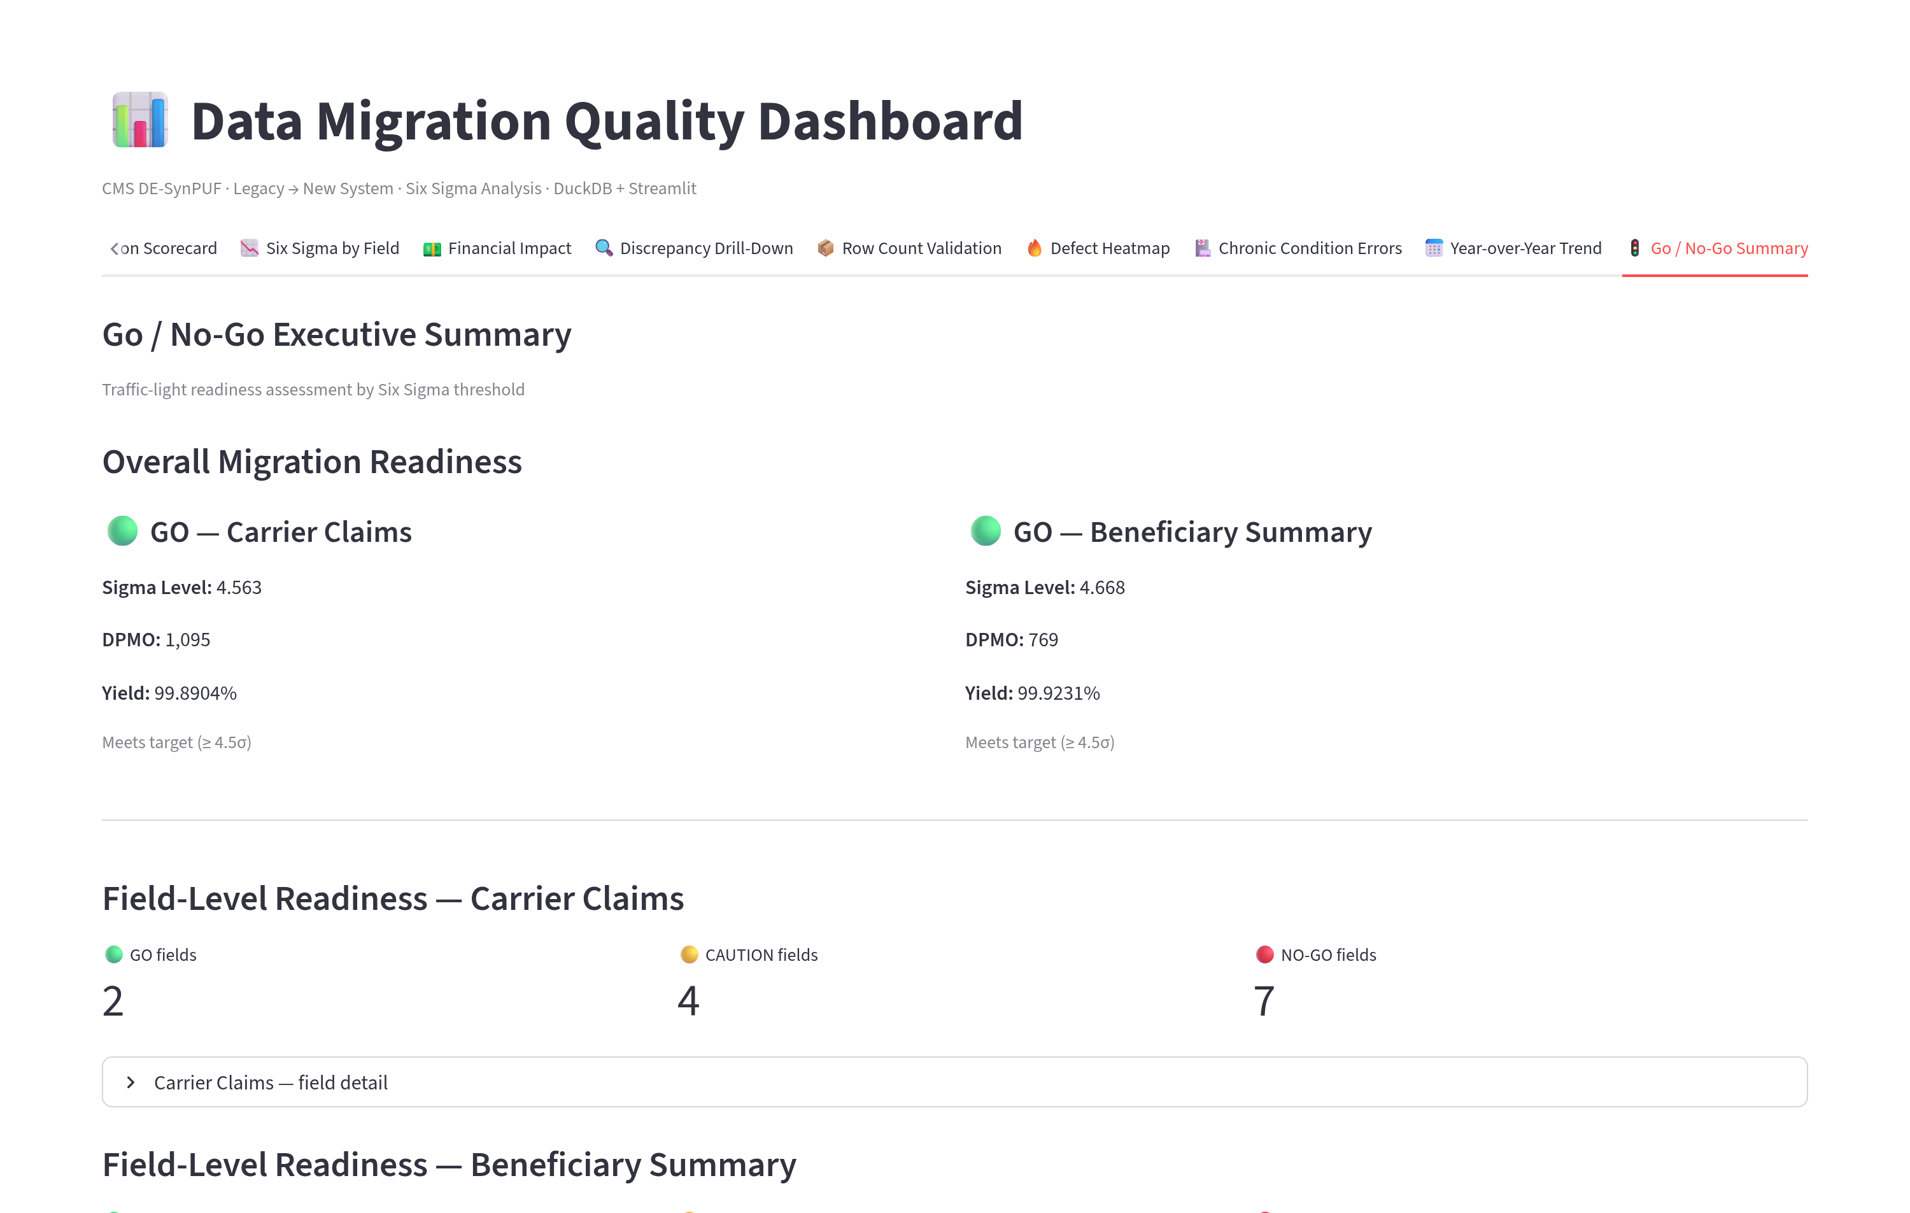
Interactive Dashboard – Go/No-Go

Slide 16
Next Steps
Error Datasets Available
Datasets showing every single field that changed after the migration were created and are available to serve the Application and Database Engineers. May help with root cause analysis (RCA).
Detailed Quality Scores Available
Detailed Quality Scores available for every field in both Beneficiary and Carrier Claims tables. Helps with setting priorities.
Analysis Positioned to Support Deep Dives
Can provide analysis to answer specific questions about the data migration that this presentation did not answer.
Analytics Improves with Time and Familiarity
Next: Interview stakeholders, gather more context about the application, data, and expectations for the migration. Then update analysis to accommodate new insights and provide custom views to answer questions that stakeholders raise.

